Slide 1
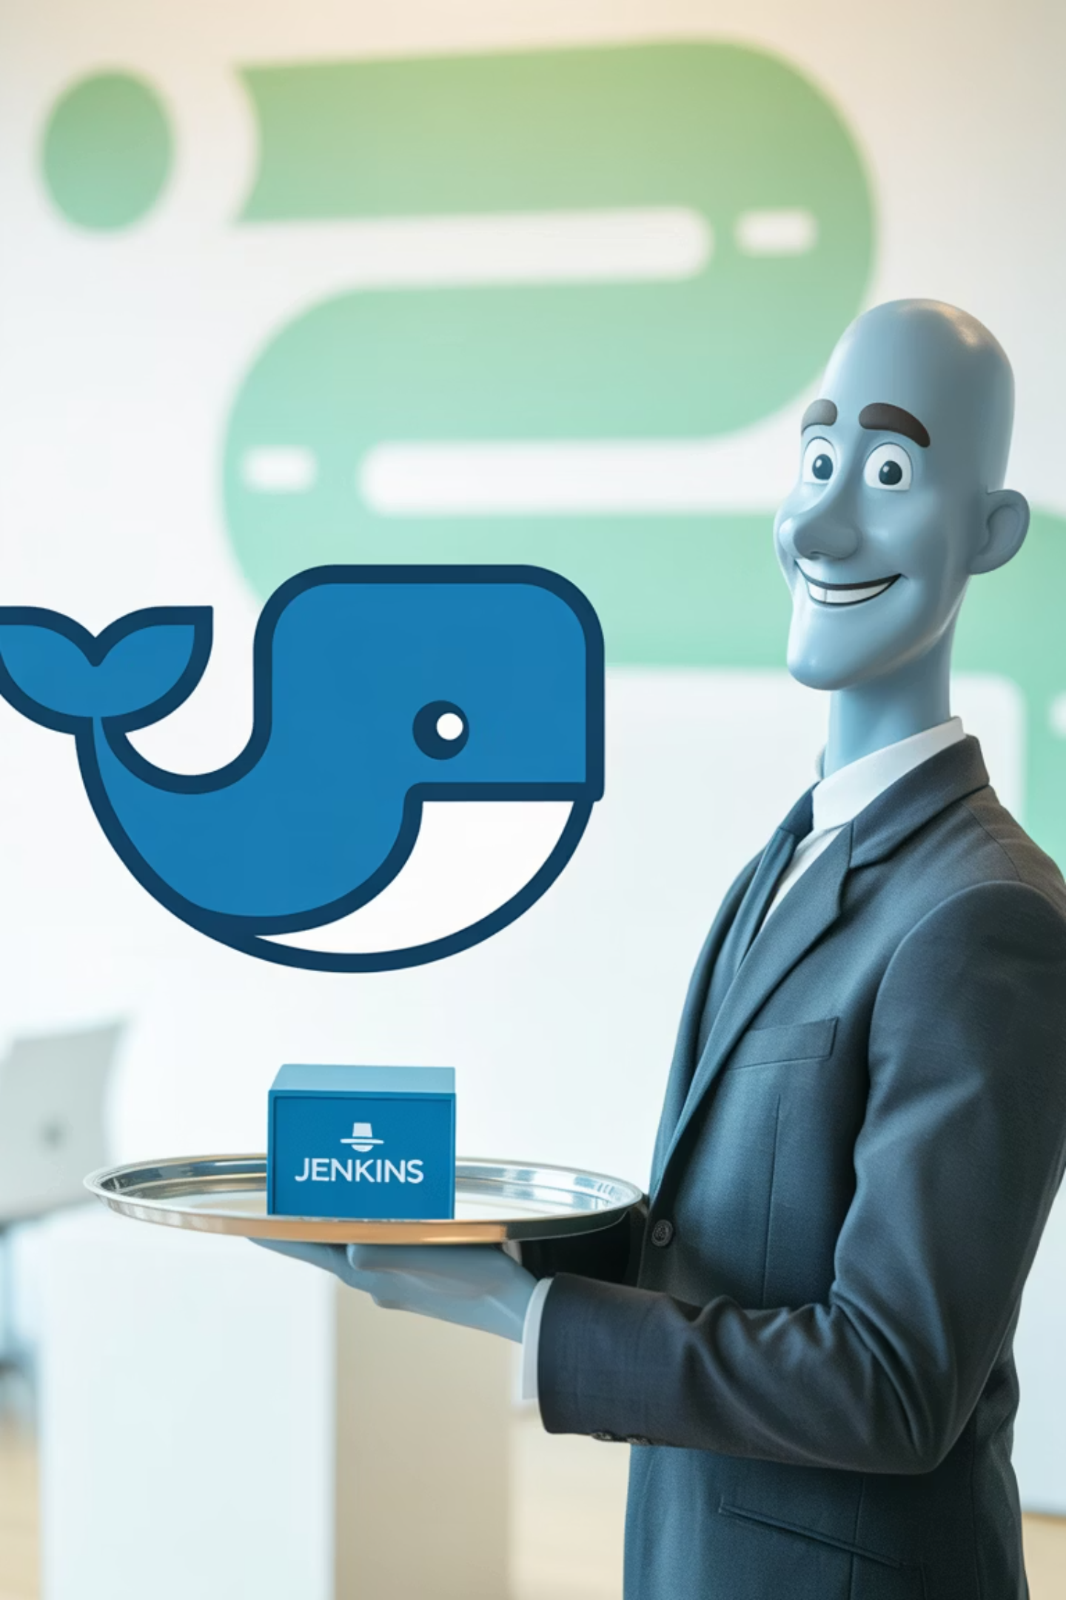
Docker Integration with Jenkins
A comprehensive guide to streamlining your CI/CD pipeline with containerization

Slide 2
Agenda
01
02
03
Why Docker with Jenkins?
Installation & Configuration
Pipeline Integration
Understanding the benefits of containerization in CI/CD
Setting up Docker on Jenkins server
Configuring Docker in Jenkins pipelines
04
05
Deployment Strategies
Security Considerations
Jenkins running in Docker vs building Docker images
Best practices for secure Docker integration

Slide 3
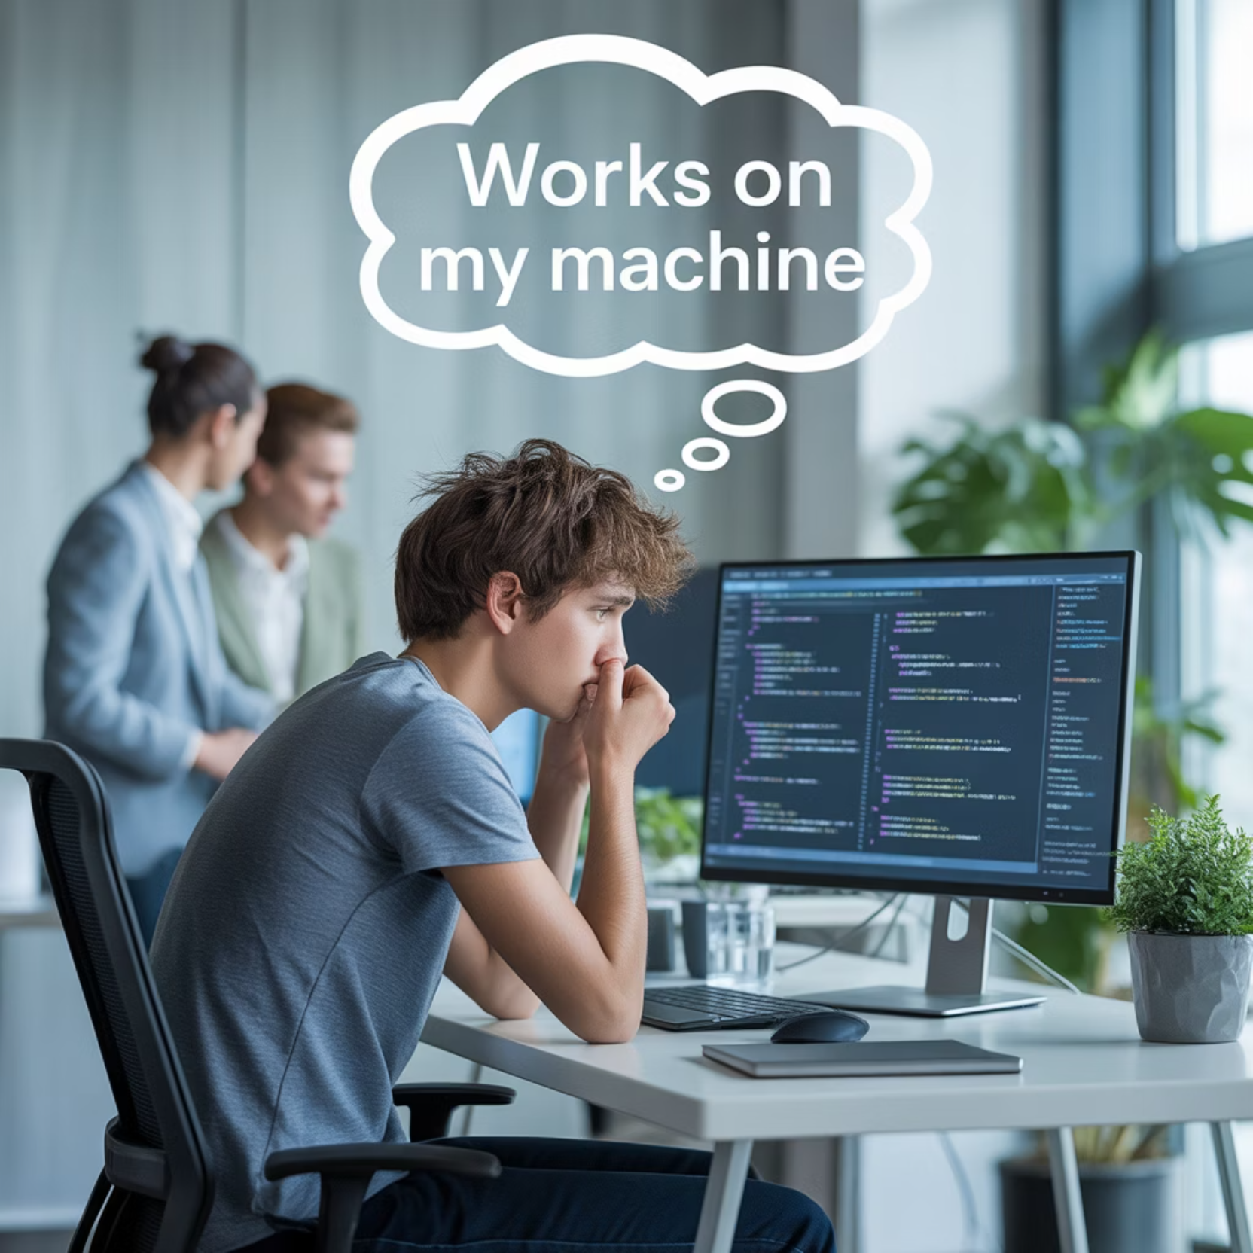
Why Use Docker with Jenkins?
Docker containers provide consistent environments across development, testing, and production, eliminating the "it works on my machine" problem. When integrated with Jenkins, they offer:
Environment consistency across all stages of CI/CD
Isolated build environments for each job
Simplified dependency management
Improved resource utilization
Faster build and deployment processes

Slide 4
Installing Docker on Jenkins Server
Add Docker's Official GPG Key
Update Package Repository
curl -fsSL https://download.docker.com/linux/ubuntu/gpg | sudo apt-key add -
sudo apt-get updatesudo apt-get install apt-transport-https ca-certificates curl software-properties-common
Add Jenkins User to Docker Group
Install Docker Engine
sudo usermod -aG docker jenkinssudo systemctl restart jenkins
sudo apt-get updatesudo apt-get install docker-ce docker-ce-cli containerd.io
These steps ensure Docker is properly installed and the Jenkins user has appropriate permissions to interact with Docker.

Slide 5


Verifying Docker Installation
After installation, verify Docker is working correctly with Jenkins:
Log in to Jenkins server as the Jenkins user
Run docker --version to confirm Docker is installed
Test Docker functionality with docker run hello-world
Check that Jenkins can execute Docker commands without sudo
If the Jenkins user cannot run Docker commands, you may need to restart the Jenkins service or the entire server for group changes to take effect.

Slide 6
Configuring Docker Inside Jenkins Pipeline
Jenkins pipelines can leverage Docker in several ways:
Docker Pipeline Plugin
Docker Agent
Docker Commands
Install the "Docker Pipeline" plugin from Jenkins Plugin Manager to access Docker commands directly in your Jenkinsfile.
Run pipeline steps inside a Docker container using the agent { docker { image 'node:14' } } syntax.
Execute Docker CLI commands directly in shell steps: sh 'docker build -t myapp:${BUILD_NUMBER} .'
These approaches can be combined to create powerful, flexible CI/CD pipelines that leverage containerization throughout the process.

Slide 7
Jenkins Deployment Strategies
Jenkins running inside Docker
Jenkins building Docker images
Jenkins itself runs as a container
Traditional Jenkins installation
Easy to upgrade and maintain
Jenkins controls Docker daemon
Consistent Jenkins environment
Builds and manages containers
Simple backup and restore
More direct access to host resources
Requires Docker socket mounting for building images
Requires Docker installation on Jenkins server
Both approaches have their merits - the choice depends on your specific infrastructure needs and security requirements.

Slide 8
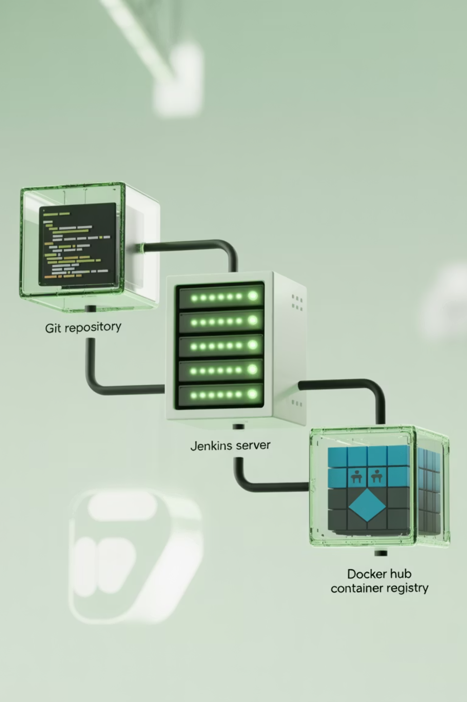
Pipeline Example: Overview
A typical Jenkins pipeline for Docker integration follows these key stages:
Clone Repository: Pull the latest code from your Git repository
Build Docker Image: Create a container image based on your Dockerfile
Push to Registry: Upload the built image to DockerHub or another container registry
This workflow enables consistent, repeatable deployments across environments.

Slide 9
Pipeline Example: Jenkinsfile
pipeline { agent any stages { stage('Clone') { steps { git 'https://github.com/username/repo.git' } } stage('Build') { steps { sh 'docker build -t username/myapp:${BUILD_NUMBER} .' } } stage('Push') { steps { withCredentials([string(credentialsId: 'docker-hub-password', variable: 'DOCKERHUB_PASSWORD')]) { sh 'docker login -u username -p ${DOCKERHUB_PASSWORD}' sh 'docker push username/myapp:${BUILD_NUMBER}' } } } }}
This Jenkinsfile defines a complete pipeline that clones code, builds a Docker image, and pushes it to DockerHub.

Slide 10

Security Considerations
Docker Socket Access
Credential Management
Mounting the Docker socket (/var/run/docker.sock) gives containers root-equivalent access to the host. Use with extreme caution and consider alternatives like Docker-in-Docker.
Never hardcode credentials in Dockerfiles or Jenkinsfiles. Use Jenkins Credentials Plugin and pass secrets at runtime.
Image Scanning
Implement vulnerability scanning for container images as part of your pipeline using tools like Trivy, Clair, or Anchore.

Slide 11

Real-Time Example
This screenshot shows a successful Jenkins pipeline that:
Clones a Git repository containing application code and Dockerfile
Builds a Docker image with the appropriate tags
Runs tests inside the container to verify functionality
Pushes the verified image to DockerHub
Deploys the application using the new container image
The entire process is automated, consistent, and repeatable across environments.

Slide 12
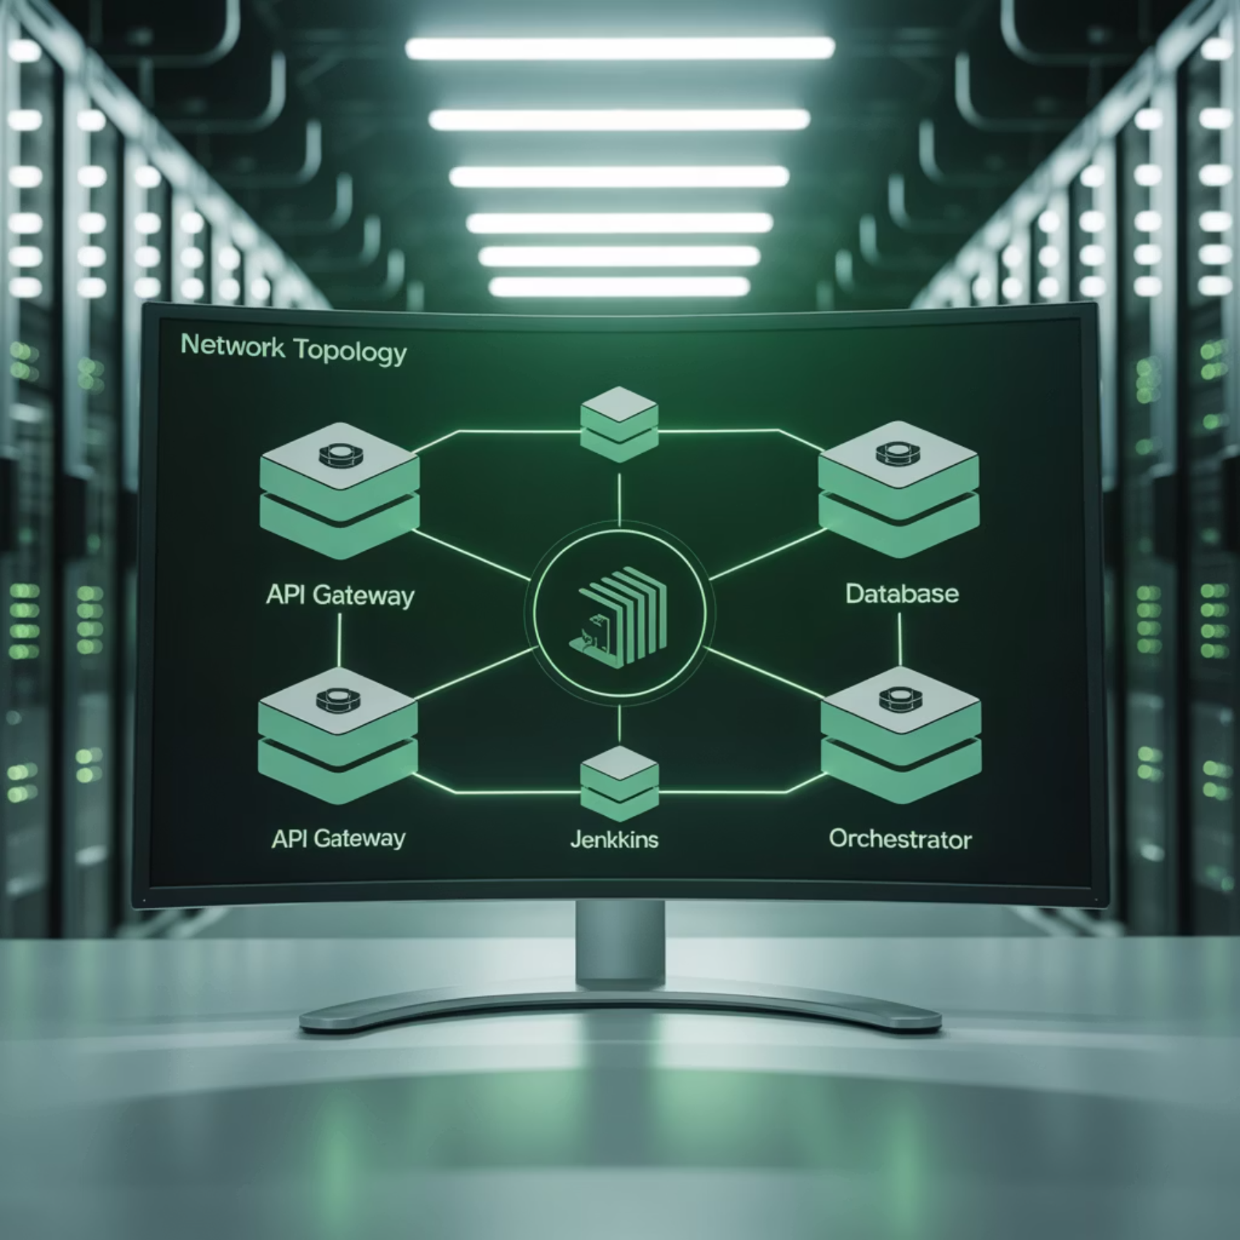
Advanced Configuration: Docker Compose
For multi-container applications, integrate Docker Compose with Jenkins:
stage('Deploy') { steps { sh 'docker-compose -f docker-compose.yml up -d' }}
This allows Jenkins to orchestrate complex application stacks with multiple interconnected containers, managing their lifecycle as a single unit.
Docker Compose enables defining and running multi-container applications, perfect for microservices architectures.

Slide 13
Troubleshooting Common Issues
Permission Denied
Registry Authentication
Resource Constraints
Symptom: "Got permission denied while trying to connect to the Docker daemon socket"
Symptom: "unauthorized: authentication required" when pushing images
Symptom: Builds fail with "no space left on device"
Solution: Implement regular cleanup of unused images and containers
Solution: Add Jenkins user to docker group and restart Jenkins service
Solution: Verify Docker Hub credentials in Jenkins and ensure proper login
Proper logging and monitoring are essential for quickly identifying and resolving these common integration issues.

Slide 14

Key Takeaways
1
Docker + Jenkins = Powerful CI/CD
The combination provides consistency, isolation, and scalability for your development pipeline.
2
Proper Setup is Critical
Ensure correct installation and permissions for seamless integration.
3
Security Requires Attention
Follow best practices to avoid exposing your systems to unnecessary risks.
With proper Docker integration, Jenkins becomes an even more powerful tool for modern software delivery, enabling teams to build, test, and deploy with confidence.

